Slide 1
Pick-Up Sportz
Sprint #0 Presentation
Chaz Del Prato, Benjamin Seo, Christine Duong, Brandon Le,
John Him, Jamil Khan

Slide 2
Business Requirement Document

Slide 3
Pick-Up Sportz
Product Detail:
The app allows a user/player to pick a sport to play (baseball, soccer, tennis, basketball, etc), select a place to go on a map, create the event and list the items that are needed to play the game.
Each player who has the app within a certain range will be notified based on the users settings.
Users will be rated to ensure quality assurance.
Each profile will allow the user to select details about them self, for example, their favorite sports they play, their skill level for that sport, and the equipment they own for that sport.

Slide 4
Strategy
Problem (User Needs):
Have more pick up games
Have pick-up games near them
Have easier accessibility to pick up games
Have a broader variety of games

Slide 5
Technological Innovations
Database-Driven Machine Learning:
Categorizes personalities, likes, and dislikes of users
Geographical Image System
Displays geographical image of surrounding areas near users

Slide 6
Total Solution
Create a mobile application that allows users to set up and join in sport events they wish to participate in
Includes a virtual map of locations that are hosting games
Allow users to choose place where a game is occuring
Display events around users that coincide with their personality, likes, and dislikes.

Slide 7
Strategy
Unfair Advantage:
Broader niche of a specific category. (Between a single aspect of a category and an overwhelming category)
Most Significant:
Machine Learning Incorporated Database that is capable of learning users’ personality, likes, and dislikes

Slide 8
Secondary Market Research
Topics Researched:
Social networking events https://showupandplaysports.com/pros-and-cons-of-pick-up-or-drop-in-games https://blog.hubspot.com/sales/face-to-face-networking-stats
Community and other types of events https://make.wordpress.org/community/2019/04/18/2018-meetup-survey/ https://blog.bizzabo.com/event-marketing-statistics#attendee
Pick up games https://www.sfia.org/press/433_Over-26-Million-Americans-Play-Basketball https://www.hsph.harvard.edu/news/press-releases/poll-many-adults-played-sports-when-young-but-few-still-play/
Community field usage https://www.nrpa.org/blog/29-number-of-times-americans-visit-their-local-parks-annually/
Benefits of parks and recreation facilities https://www.nrpa.org/uploadedFiles/nrpa.org/Advocacy/Resources/Parks-Recreation-Essential-Public-Services-January-2010.pdf

Slide 9
Secondary Market Research
Things we researched for each topics:
Demographics
Frequency in attendance
Reasons for attendance
Location
Networking Potential

Slide 10
Secondary Market Research
What we found:
Competitors cover either one sport or a variety of other topics, not just sports
Most don’t go to events that are far away
Majority hear about event like pick up games through friends.

Slide 11
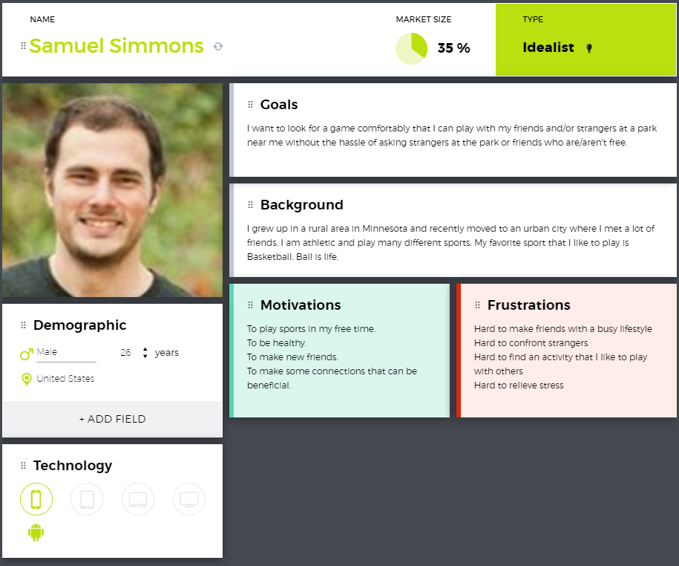
Personas
Persona: User that is looking for a particular sports to play with friends and/or strangers at a nearby park.

Slide 12
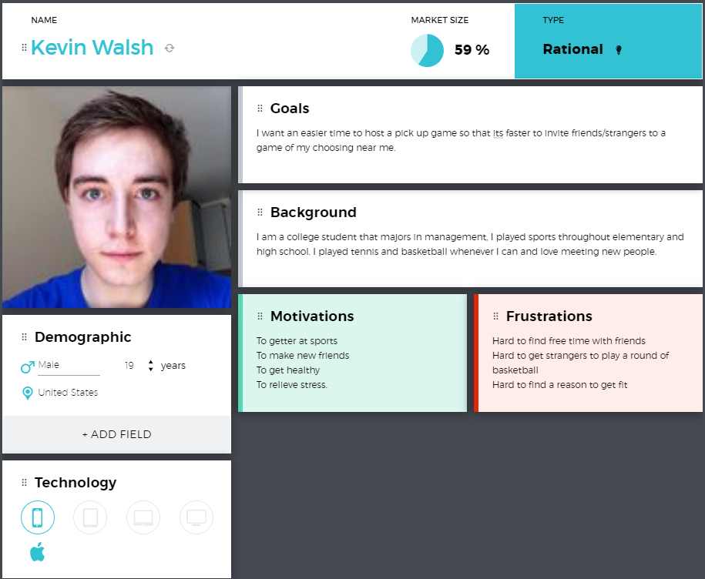
Personas
Persona: Users that want to invite friends/strangers to a pick up game of their own choosing

Slide 13
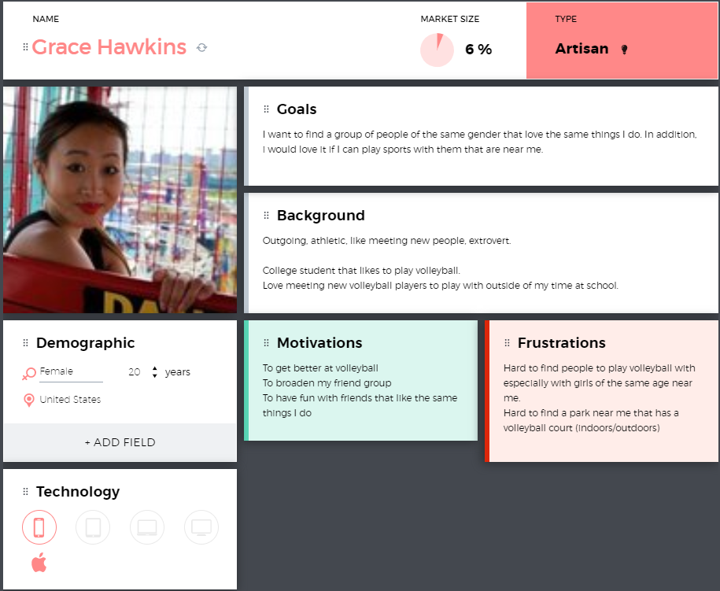
Personas
Persona: Users that want to network with a group with similar interests face to face from a pick up game/event.

Slide 14
Personas
Most important persona: Kevin Walsh
Love meeting people
Difficult time finding time to play sports
Outgoing

Slide 15
Primary Market Research
Questions asked based off of the Secondary Market Research:
How often do you play pick up games?
Do you enjoy playing in pick up games?
Is networking important to you?
Would you network with other people in a sports environment?
How important is engaging with the community to you?
Do you ever play sports at these community events?
Is the place of the event important to you?
What sports do you like to play?
Did you make new friendships or business partnerships while networking?
Do you attend events near you?
What is your gender?
Where did you hear about an event?
What is your age?

Slide 16
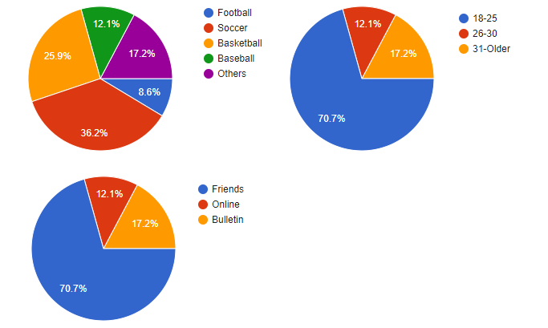
Primary Market Research

Slide 17
Primary Market Research
Validation of user needs:
70.2% of survey takers participated in a pick up game or community event that they heard from their friends.
Only 12.3% of survey takers heard from online and 17.5% have heard from offline bulletin board.
This shows that not a lot of people are finding events online.
With this small sample, we can clearly see that most who hear about these kinds of events; attend, enjoy, and network.
Therefore, out innovative technology fits the user’s needs in allowing a broader and efficient accessibility.

Slide 18
Competitors
OpenSports: (most significant)
A pick up game application that can host and join events, organize your schedule, and message other players.
Eventbrite:
Event management and ticketing website.
Allows users to browse, create, and promote local events.
Meetup.com:
Service that allows users to organize online groups that host in-person events for people with similar interests.

Slide 19
Competitors
Product features that competitors lack:
Even though these competitors have some similar features from each other, they do not have features that other competitors have.
Our product have those features:
Graphical Image of Location and Direction
Machine Learning to learn personality, likes, and dislikes
Specific Niche

Slide 20
Commercialization Strategy
After we have our product, our goal will be to partner with workout facilities such as gyms and public parks to advertise our app as a more sophisticated way of finding a means of finding a pickup game. This will get word out of our app to athletes who desire this functionality in their means to find teams and players to interact with them. I means we can use to contact our potential customers is through the database of these workout facilities who already have data on their customers.

Slide 21
Monetization Strategy
Our plan is to have the application be free to the users of the app. The means in which we can profit from our product is allowing companies to advertise on our platform. This will generate revenue from the traffic of our application. We will also partner with athletic companies who can sponsor their sports equipment that will be featured in our pickup games. In addition, there is a possibility where users or companies can start a tournament. This could increase our profit from sponsors, fees, donations, etc

Slide 22
Sprint #0

Slide 23
Sprint Goals
Creating a Business Requirements Document
Creating a Management Plan
Creating a Database
Populating a Sprint Board

Slide 24
Prioritization Process
We prioritized our tasks based on the deadlines for the tasks.
Tasks due in the beginning of the sprint are prioritized as high priority.
Tasks that are due in the middle of sprint are prioritized as medium.
Tasks with a deadline near the end of the sprint are prioritized as low.

Slide 25
User Stories
As an app admin, I want to be able to communicate with a database, so that I can keep records of all information within the app.
As a member of the management team, I want to be able to have a Business Requirements Document, so that I can describe the characteristics of our proposed system.
As a member of the management team, I want to be able to have a Management Plan, so that I can understand how the project is executed, monitored, and controlled.
As a member of the management team, I want to be able to have an interactive Sprint Board, so that we can determine tasks that need to be completed for the current sprint.

Slide 26
Tasks Completed
Created Business Requirements Document
Project Detail
SWOT Analysis
Market Segments
Primary/Secondary Market Research
Created Management Plan
Gantt Chart
Burndown Chart
Project Planning Matrix
Created and initialized a database for data storage and collection

Slide 27
Management Plan

Slide 28
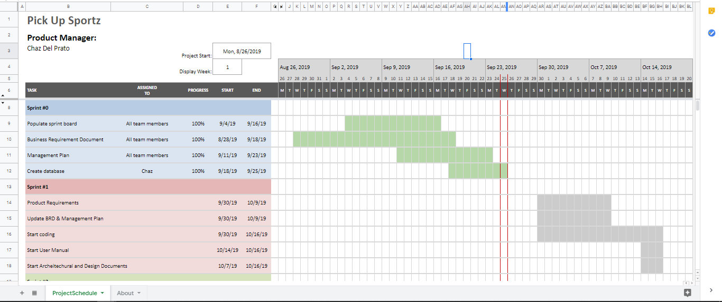
Gantt Chart

Slide 29
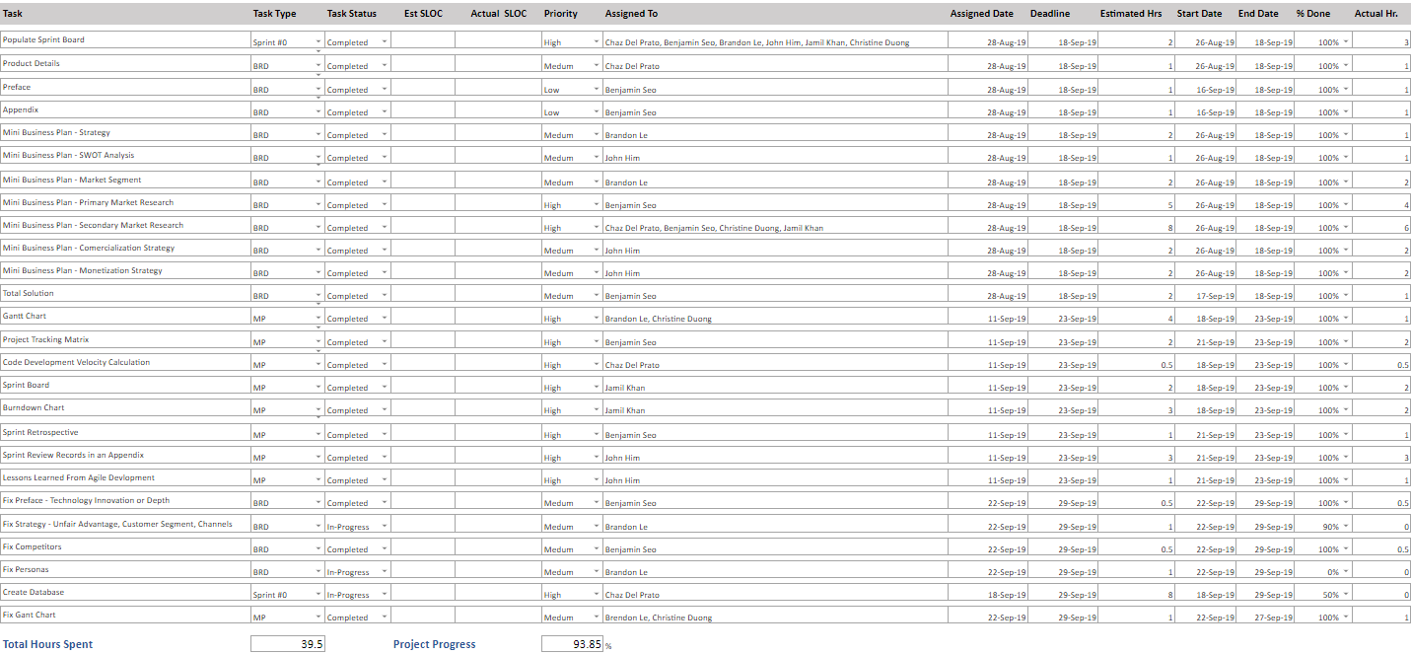
Project Tracking Matrix
Need to insert tracking matrix in this slide

Slide 30
Code Development Velocity
Our Team Sprint Capacity is 3 (lab hours) x 3 (weeks) x 6 (group members) for a total of 54 hours.
The only code development that has been done is for the Database. Entering in the SQL queries is the only code that has been created. The total amount of time spent on developing the database is 2 hours.

Slide 31
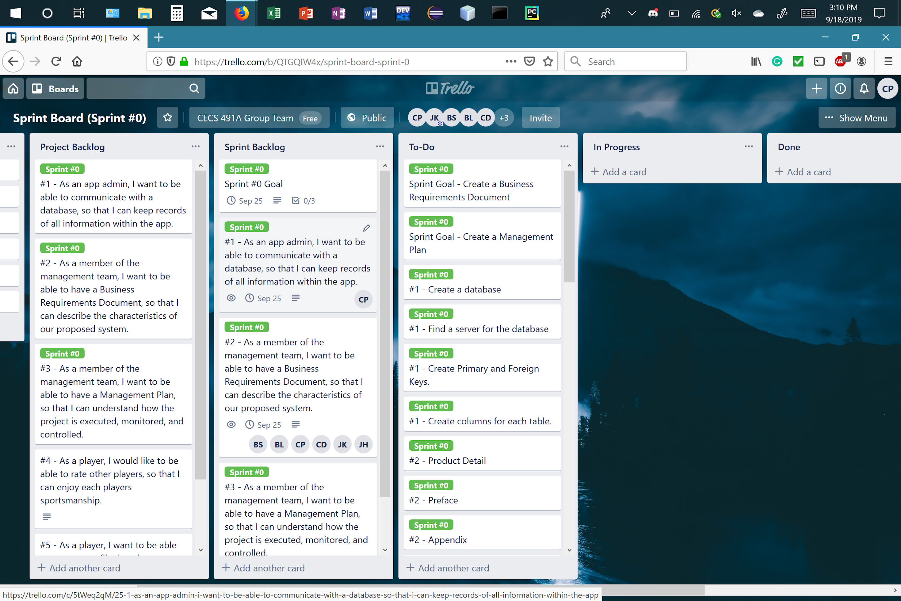
Sprint Board

Slide 32
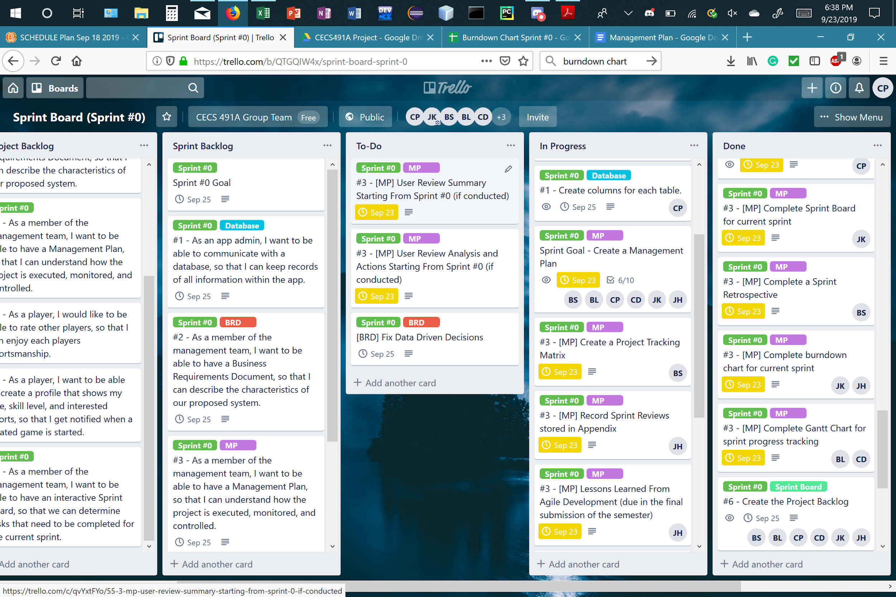
Sprint Board

Slide 33
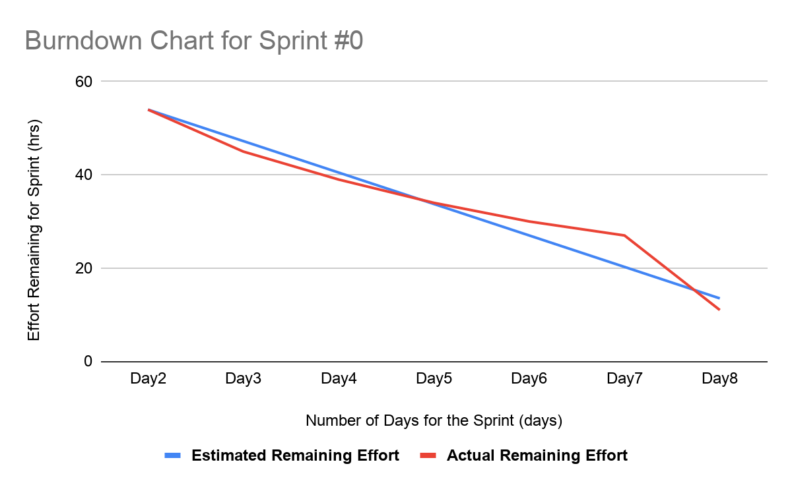

Slide 34
Sprint Retrospective
Our sprint goals consist of :
Creating a Business Requirement Document
Creating a Management Plan
Creating a database
Creating a sprint board
Our sprint goals have been met. Even though there were a bit a of hiccups along the way, we have completed the sprint goals on time.
Our team’s total velocity is 54 hours since:
3 hours per week * 3 weeks * 6 members
Current hours worked: ~ 40 hours
Our burndown chart for sprint #0 is looking good. With all the tasks that have been completed, we can clearly see the graph slowly heading down, signifying that we are almost done with a task.
Team velocity for next sprint:
Pay attention to assignment date and due date so burndown chart looks smoother.
Increase the hours per week

Slide 35
Sprint Review Records
Our group reviewed what we accomplished in the Sprints by going over the individual task accomplished.
We talked about the challenges we came across in the Business Requirement Documents such as how we want to approach the business strategy for our mobile application.
We met the criteria for the document by fulfilling all of it’s requirements such as analysis, research, and strategies for our application.
Similar to how we did the Management Plan, after completing a section requirement for the document, we discussed how we can incorporate the information to other parts of the document.

Slide 36
Team Metrics
“Smooth Time Smooth Flow”
Assign tasks to personal desire
Assign remainder tasks with teammates that have less tasks
Start early with minimal effort
Go hard throughout the first week
So that the remaining week is easier
Results in smoother work pace with less stress.

Slide 37
Lessons Learned from Agile
From sprint #0, we were able to learn the time required to complete a Business Requirement Document, which was approximately a few weeks as we had to complete parts such as coming up with our primary research, strategy for our business plan, SWOT analysis, secondary research, determining the size of the market, and commercialization and monetization strategies.
We had sufficient time to get early versions of this document and fix any dilemmas that we had, such as fixing/adjusting what primary research questions to ask and changing our business strategy.
For our Management Plan we learned about how to organize work among a team to accomplish a project using tools such as a Sprint Board and track progress you have made through a Gantt Chart.

Slide 38
Plans for the Next Sprint
Organized the data required for database system development.
Identified columns for table information.
Created tables required for data storage.
Initialized application framework and system architecture
Tested the initial stages of code developed.
Started implementation of front-end functionality.
Database system, Working code for application, Basic front-end functionality

